Slide 1
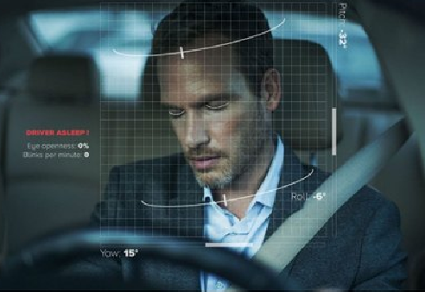
2022 Major Project
Driver Drowsiness Detection
Team Guide:- Dr. Anil Kumar Dubey
Team Members:
Anshika Singhal
(1803210027)
Kashish Sharma
(1803210101)
Naman Jain
(1803210078)

Slide 2
Agenda
Motivation
Objective
Scope
Software and Hardware Requirements
Related Previous Work
Proposed Method
Deliverables
Snapshots/Implementation
Gantt Chart
Conclusion
References
Questions & Answers

Slide 3
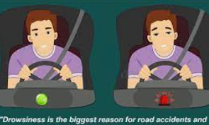
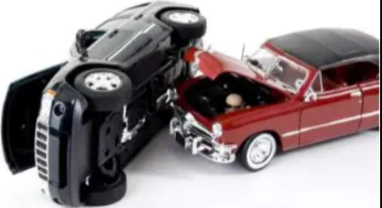
Motivation
Nowadays the driver safety in the car is one of the most wanted system to avoid accidents . The National Transportation Safety Board(NTSB) in the United States have indicated the significant danger of fatigued drivers operating heavy vehicles. 52% of heavy truck single vehicle accidents were fatigue-related.
Annually, it is estimated there are 40,000 injuries and 1,500 fatalities are caused by fatigued persons at the wheel. Driver drowsiness involves a high percentage (30%) of traffic accidents .
This motivates us to make project on drowsiness detection to ensure the safety and reduce the no. of car accidents.

Slide 4
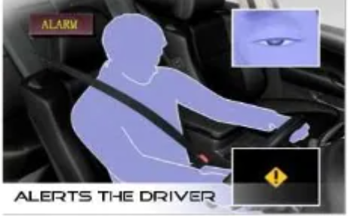
Objective
The main objective of this is to develop a drowsiness detection system by monitoring the eyes and when the system detects drowsiness ,it alerts the driver. It is believed that the symptoms of driver fatigue can be detected early enough to avoid a car accident. Detection of fatigue involves the observation of eye .

Slide 5
Scope/Future’s
The Anti-drowsiness Alarm will help the driver wake up at the right moment before any mishappening.
It will also help in Drink and Drive protection
The system can be used not only for automobiles but also for other modes of tranportation such as airplane, trains, etc.
We can further add features like sensor to track the heart rate in order to prevent accidents due to sudden heart attacks to drivers.
Same model can be used for various purposes. For example, to prevent the users from sleeping . It can be used for other uses like Netflix and other streaming services, system will detect whether the person is sleeping or not and stop the video accordingly.

Slide 6
Hardware and Software Requirements
Software-
IDE: -
Jupyter Notebook/Python IDE
Libraries:
Numpy, Keras , Tensorflow
Opencv, Pygame
Hardware-
A PC or Laptop
RAM (8 GB)
I5 Processor (Minimum)
Webcam

Slide 7
Previous Related Work
Previously, many studies have been conducted in dizziness detection and in various areas. It is proved to be very beneficial for every domain . Industries designed dizziness detection according to their work culture, architecture of data and it help them increase their revenue.
The following measures have been used widely for monitoring drowsiness:
(1) Vehicle-based measures—A number of metrics, including deviations from lane position, movement of the steering wheel, pressure on the acceleration pedal, etc., are constantly monitored .
(2) Behavioral measures—The behavior of the driver, including yawning, eye closure, eye blinking, head pose, etc., is monitored through a camera.
(3) Physiological measures—The correlation between physiological signals ( (ECG), (EMG), (EoG)) and driver drowsiness has been studied by many researchers.
(4)Researchers have also used subjective measures where drivers are asked to rate their level of drowsiness either verbally or through a questionnaire.

Slide 8
Previous related work-1
With a focus on fatigue driving detection research, a fully automated driver fatigue status
detection algorithm using driving images is proposed. In the proposed algorithm,
the multitask cascaded convolutional network (MTCNN) architecture is employed in face
detection and feature point location, and the region of interest (ROI) is extracted using feature
points.
A convolutional neural network, named EM-CNN, is proposed to detect the states of the
eyes and mouth from the ROI images.
The percentage of eyelid closure over the pupil over time (PERCLOS) and mouth opening degree
(POM) are two parameters used for fatigue detection.
Experimental results demonstrate that the proposed EM-CNN can efficiently detect driver
fatigue status using driving images. The proposed algorithm EM-CNN outperforms other
CNN-based methods, i.e., AlexNet, VGG-16, GoogLeNet, and ResNet50, showing
accuracy and sensitivity rates of 93.623% and 93.643%, respectively.

Slide 9
Previous related work-2
This work shows a surveillance system developed to detect and alert the vehicle driver about
the presence of drowsiness. It is used a smart phone like small computer with a mobile application
using Android operating system to implement the Human Computer Interaction System.
For the detection of drowsiness, the most relevant visual indicators that reflect the driver’s
Condition are the behavior of the eyes, the lateral and frontal assent of the head and the yawn.
The system works adequately under natural lighting conditions and no matter the use of driver
accessories like glasses, hearing aids or a cap.
Due to a large number of traffic accidents when
driver has fallen asleep this proposal was developed in order to prevent them by providing a
non-invasive system, easy to use and without the necessity of purchasing specialized devices.
The method gets 93.37% of drowsiness detections.

Slide 10
Previous related work-3
The proposed HOG- Linear SVM system aims at successfully identifying drivers who are in a state
of drowsiness and immediately wake them up by sounding an alarm. This system requires a
camera that is to be used to obtain a live running video stream of the driver behind the wheel.
This video stream is analysed for detecting drowsiness on the driver.
Initial Camera Setup
B. Face Detection
C. Face landmark Detection and Extraction
D. Eye Aspect Ratio (E.A.R) Computation:
EAR = (||p2 − p6|| + ||p3 − p5||)/( 2||p1 − p4|| )
where p1, p2, p3, p4, p5, and p6 are the 2D landmark locations.
E. Drowsiness Evaluation and counter measures

Slide 11
Literature Review Table
Sr.No | Paper/Book Title | Authors | Publication Details | Summary
1. | Driver Fatigue Detection Based on Convolutional Neural Networks Using EM-CNN | Zuopeng Zhao,Nana Zhou,Lan Zhang, Hualin Yan,Yi Xu,and Zhongxin Zhang | Computational Intelligence and Neuroscience | In the proposed algorithm, the multitask cascaded convolutional network (MTCNN) architecture is employed in face detection and feature point location, and the region of interest (ROI) is extracted using feature points.
2. | Real Time Driver Drowsiness Detection | Eddie E Galarza, Franklin Silva, Eddie Galarza,Paola M.Vilasco | Proceedings of the International Conference on Information Technology & Systems (ICITS 2018) | Real Time Driver Drowsiness Detection Based on Driver’s Face Image Behavior Using a System of Human Computer Interaction Implemented in a Smartphone
3. | Drowsiness Detection System using Machine Learning | S. Jansi Rani1 , Anand Rajasekharan2 , Chandrasekhar A R 3 | INTERNATIONAL JOURNAL OF INNOVATIVE RESEARCH IN TECHNOLOGY | This research uses Convolutional Neural Network to predict drivers drowsiness.
4. | A study on driver fatigue recognition based on SVM method | Y. Gao, Z. You, H. Zhang, J. Zhang, M. Zhou, and C. Wu | Fatigue Recognition Based on SVM | With the purpose to propose one recognition fatigue model, the measurements of vehicle control characteristics, physiological and psychological under fatigue have been studied through dynamic and static driving tests in the paper

Slide 12
Proposed Method
Step 1 – Take image as input from a camera.
Step 2 – Detect the face in the image and create a Region of Interest (ROI).
Step 3 – Detect the eyes from ROI and feed it to the classifier(CNN).
Step 4 – Classifier will categorize whether eyes are open or closed.
Step 5 – Calculate score to check whether the person is drowsy.

Slide 13
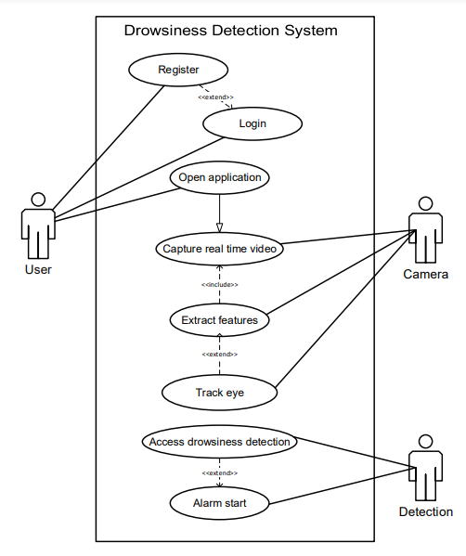
Use case diagram

Slide 14
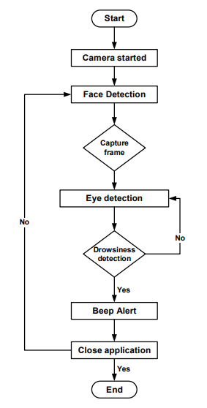
Data Flow Diagram

Slide 15
Implementation
A. Data Gathering
Dataset is prepared by collecting the images from the image data from the Kaggle.There are a lot of datasets that contain the data regarding the same details of the eye and facial movement depicting the sleepy behaviour of the person.
B. Data Cleaning
One of the most significant steps in any machine learning project is data cleaning. There are several different methods of statistical analysis and data visualization techniques in the dataset that you can use to explore the data to identify the appropriate data cleaning operations to be conducted. In our dataset, we cleaned all the null values and
checked whether all the datatypes are valid.
C. Data Exploration
Also known as E.D.A, exploratory data analysis is a very important phase in researching and investigating various data sets and summarizing their significant characteristics, often using different methods of data visualization. It allows to obtain repeated trends, spot anomalies, test theories and conclusions to decide the best way to monitor data sources to get the results with greater precision.

Slide 16
Implementation(continue..)
D. Prediction using Machine learning
The model we will be using to build it is with Keras using Convolutional Neural Networks (CNN). A convolutional neural network is a special type of deep neural network which performs extremely well for image classification purposes. A CNN basically consists of an input layer, an output layer and a hidden layer which can have multiple layers. A convolution operation is performed on these layers using a filter that performs 2D matrix multiplication on the layer and filter.
The CNN model architecture consists of the following layers:
Convolutional layer; 32 nodes, kernel size 3
Convolutional layer; 32 nodes, kernel size 3
Convolutional layer; 64 nodes, kernel size 3
Fully connected layer; 128 nodes
The final layer is also a fully connected layer with 2 nodes. A Relu activation function is used in all the layers except the output layer in which we used Softmax.

Slide 17
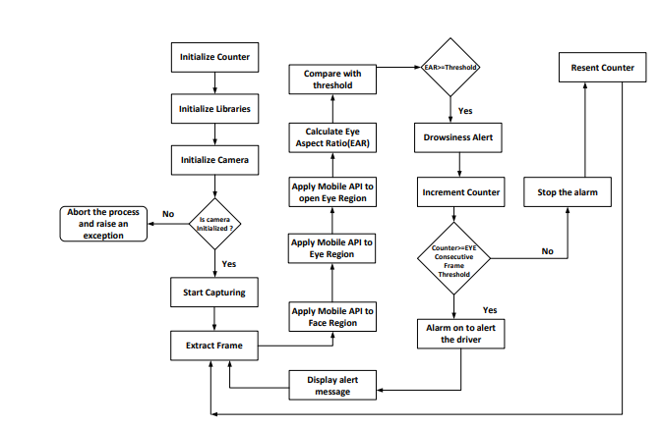
Working Mechanism

Slide 18
Deliverables
Drivers
Common People
Traffic Police

Slide 19
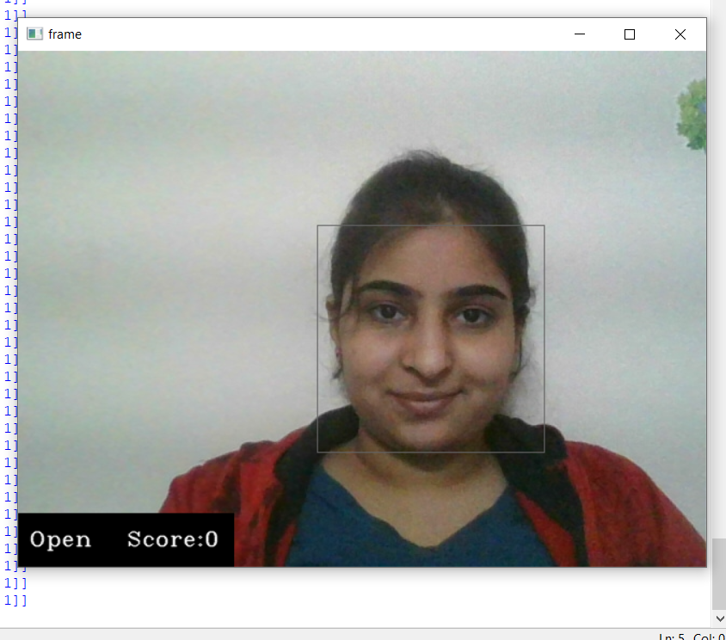
Snaphots:
This image shows that when the eyes of
the driver are open or he is awake .At that time the Score is 0 or less than threshold value and label is open. In this case alarm will not beep.
Label: Open , represents eyes are open
Score : It’s value if reached greater than threshold value alarm ill beep.

Slide 20
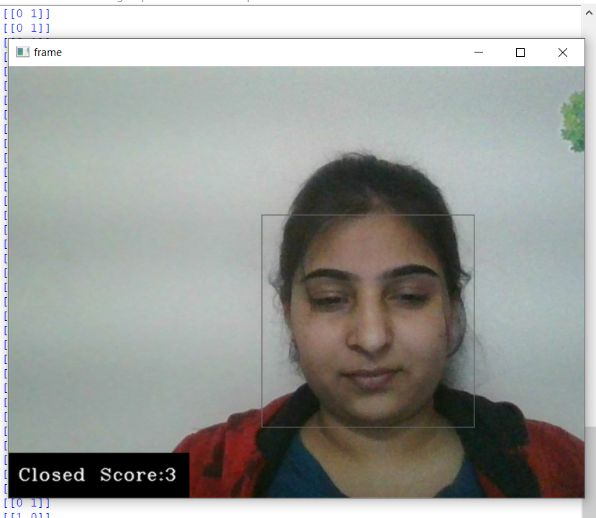
In this, the eyes are partially closed ,as it is closed for less time and score has not crossed threshold value, so it’s not showing any alarm frame but when eyes partially closed for more time and score increased above threshold then alarming frame with red color will be shown .Also there will be a beep which will alert both the driver and the fellow passengers.
Label: Closed , we are considering partially closed eyes as closed.
Score : It’s value if reached greater than threshold value alarm ill beep.

Slide 21
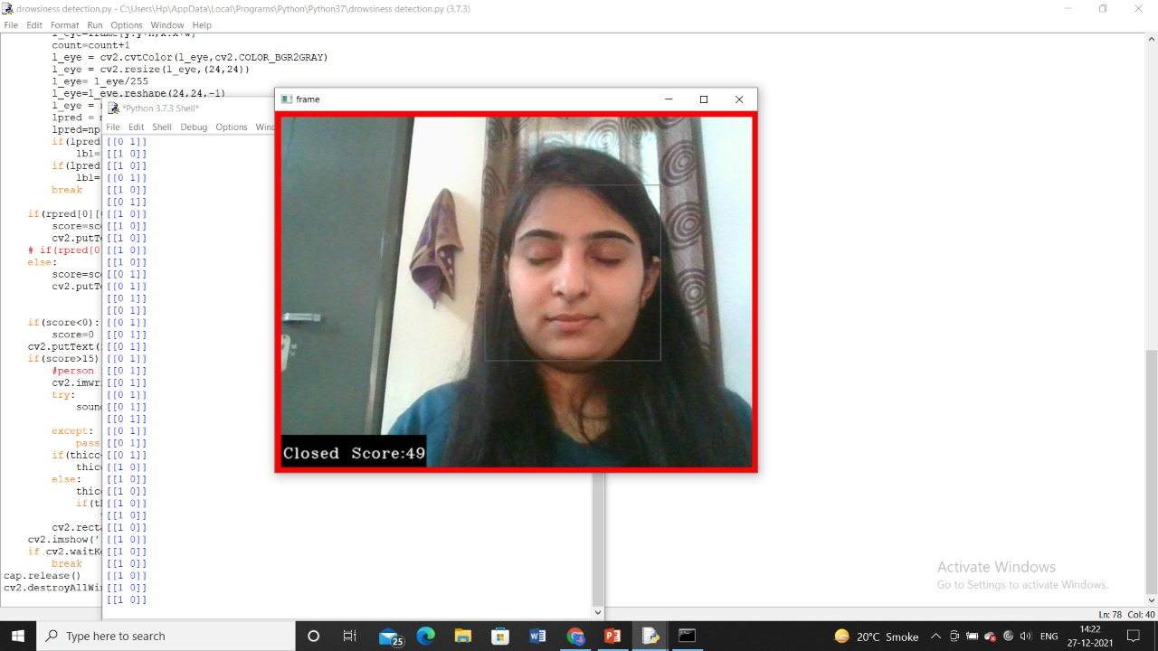
In this the eyes are fully closed and the
score has crossed the threshold so it is showing
The alarming frame with red color. Also there
will be a beep which will alert both the driver
and the fellow passengers.
Label: Closed , represents eyes are closed

Slide 22
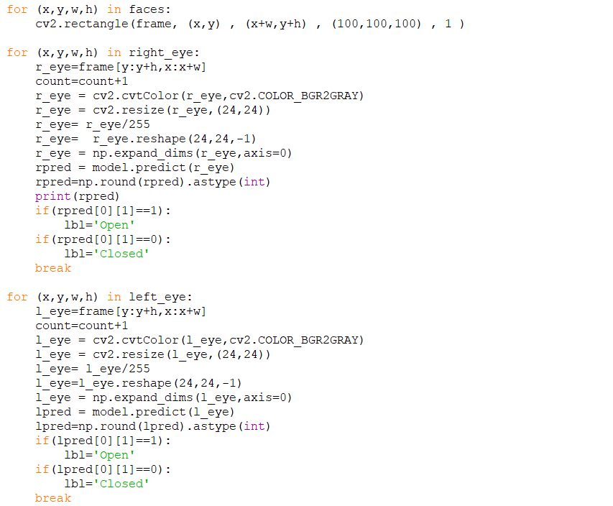
Code Snippets
The following figure shows the selection of frames like x,y,w,h coordinates are taken and a rectangular frame on face is selected. then on it eye frame is selected and is converted to gray scale image.The pixels are stored in the array which is dynamically expanding and then prediction is done based on the pixel values.

Slide 23
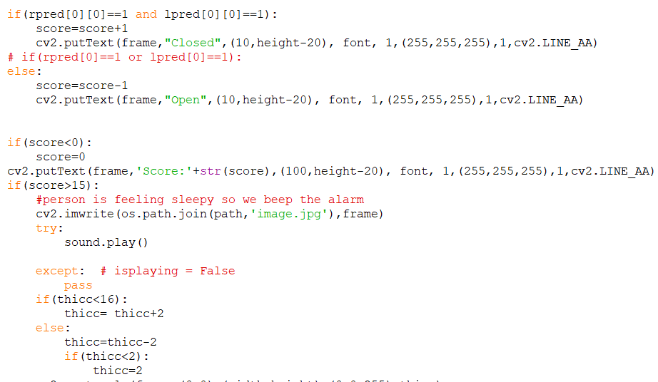
Code snippets (continue…)
If both the eyes are closed then the
output will be displayed as closed
because the pixel values are as 1.
Since the given threshold is 15 . So if the
score is greater than 15 then the system
will beep the alarm and the driver will
woke up.

Slide 24
Gantt Chart

Slide 25
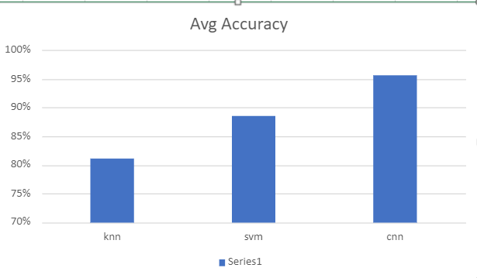
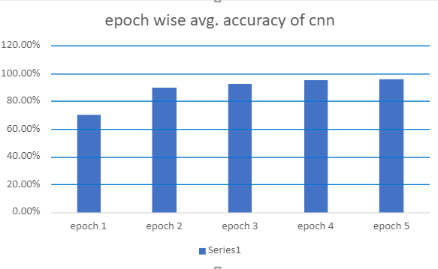
Graphs
Graph 1
Graph 2
Graph1 is showing average accuracy of different algorithms including KNN, SVM, CNN in our system.
KNN with 82% accuracy, SVM with 88 % accuracy and CNN with the highest accuracy 96 %.
Graph 2 representing epoch wise accuracy of the CNN algorithm in our system

Slide 26
Conclusion
By making use of the technologies of computer vision, an interdisciplinary science that deals with how computers can be made more intelligent by developing techniques that help them gather high-level understanding from digital images or videos, a solution can be developed for this problem of detecting and notifying of driver drowsiness.
The main idea behind this project is to develop a computer vision system, using OpenCV, which is non- intrusive that can automatically detect driver drowsiness in a real-time video stream and will alert the driver by playing an alarm if they appear to be drowsy.
This system would make use of an algorithm that detects the eye landmark points of the driver and based on this can determine if the driver is in a drowsy state or not, and appropriately sound an alarm.

Slide 27
References
[1] Guo, G., Li, SZ., Chan. K., (2000). Face recognition by support vector machines, In Proceedings fourth IEEE international conference on automatic face and gesture recognition, pp. 196-201.
[2] Wilson PI, Fernandez J., (2006). Facial feature detection using Haar classifiers. Journal of Computing Sciences in Colleges.
[3] Y. Gao, Z. You, H. Zhang, J. Zhang, M. Zhou, and C. Wu, (2016). A study on driver fatigue recognition based on SVM method, in Proceedings of the 4th International Conference on Transportation Information and Safety ICTIS, pp. 693–697, Banff, Canada.
[4] J.-J. Yan, H.-H. Kuo, Y.-F. Lin, and T.-L. Liao, (2016). Real-time driver drowsiness detection system based on PERCLOS and grayscale image processing, in Proceedings of the 2016 International Symposium on Computer, Consumer and Control (IS3C), pp. 243–246, Xi’an, China.
[5] T. Danisman, I.M. Bilasco, C. Djeraba and N. Ihaddadene., (2010). Drowsy driver detection system using eye blink patterns, Universite Lille 1 & Telecom Lille 1, Marconi, France.

Slide 28

Questions and Answers

Slide 29


